Slide 1
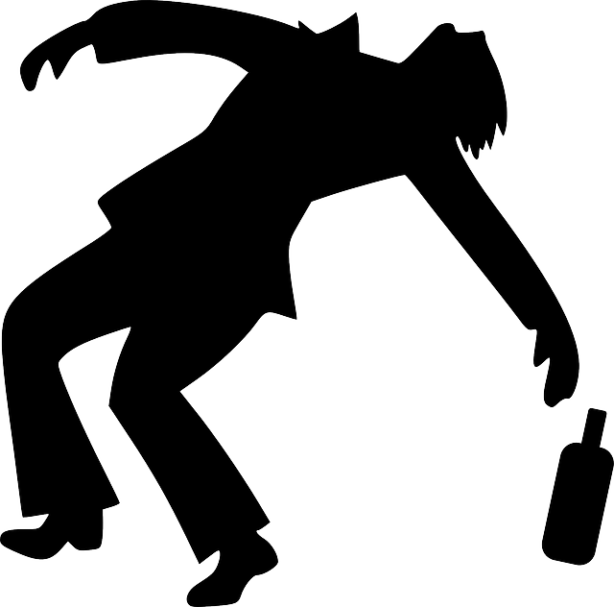
Case 3
By A.C.
February 2016

Slide 2

Case Summary
You are a student government senator. In the last few weeks you have started to see a lot of videos on social media showing students drinking alcohol in creative ways and then challenging their friends to do the same. When you logged into Facebook this morning, you noticed a video of John, one of your fellow senators, had been posted. John is not 21, and in the video, he is wearing his student government sweatshirt as he chugs several beers. You work hard to follow the rules and always represent student government professionally, and you feel that John has done a disservice to the organization. John is a very popular and effective student leader, and there is a tacit understanding in the organization that in college, people drink underage. John’s Facebook is also set to private, so only his friends will see the video.

Slide 3

Ethical Issues in the Case
Follow the rules and guidelines of the club
Follow the laws of society
John makes club look bad
Dilemma between friends and duties
Social media – private?
Ethical Argument(s)
1. If you get fired from Senator position, you have done a disservice to the club
2. You do a disservice to the club.
3. You will get fired from the senator position
Or
1. If you are excluded from camaraderie, you have turned in a fellow senator
2. You turn in a fellow senator
3. You are excluded from camaraderie

Slide 4
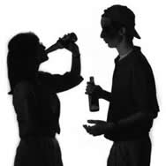
Possible Solutions
Be quiet
Retain positive relationship with club members (++)
Lost sense of Professionalism (-)
Retain valuable club member (+)
Allows for other members to behave inappropriately (-)
Turn him in
You follow the rules, so he should be held accountable
Club retains sense of professionalism (+)
The club will lose a valuable and popular member (-)
The other members will no longer be friendly to you (-)
Loss sense of group camaraderie (+)

Slide 5

What would I do?
Be quiet, let him get away with it.
Personal experience similar – RA role at Lasell
His inappropriate posts are private
Losing a valuable team member, and losing the positive camaraderie is a huge cost
Drinking is a norm of college society
The only issue is image – other students already know John drinks
If the problem was that bad, wouldn’t somebody else say something?

Slide 6

Questions
Do you think most people would choose to keep quiet?
Are most leaders on college campuses drinkers? Is it okay?
An effective leader can relate to their followers, and the followers drink, wouldn’t it make sense for the leader to drink with the followers, to participate in a “team building exercise”?
Should a private social media post be taken seriously?
Would it be any different if you heard it from a friend?
Is it better to remain professional, or remain effective?

